Slide 1

WELCOME
To IDEA
Innovative Driving Education Academy

Slide 2
DTIDEA Unit 7
Delivering knowledge of driving industry training standards

Slide 3

House Rules
Mute Microphones
Take Notes
Interact as much as you need
Use chat
Hand up to speak and unmute
Session is not being recorded

Slide 4
Agenda
NSDRT - National Standards for Drivers and Rider Trainers
National standards for driving cars and light vans

Slide 5
Jahangir Shah
Introduce yourself to the group.
What do you do?
Where are you based?

Slide 6
What is the NSDRT?

Slide 7
NSDRT Document
What is the NSDRT?
This national standard sets out the skills, knowledge and understanding needed to deliver a programme of driver/rider training. It covers training for drivers or riders of all types of cars, light vans, motorcycles and mopeds for use on the road. It covers training for licence acquisition and post-test driving/riding programmes.

Slide 8
What is the National Standard for driving cars and light vans?

Slide 9
National Standard for driving cars and light vans
What is the National standard for driving cars and light vans?
The skills, knowledge and understanding you need to be a safe and responsible driver of a car or van (category B vehicle).

Slide 10


Slide 11
Andy Lloyd
Introduce yourself to the group.
What do you do?
Where are you based?

Slide 12
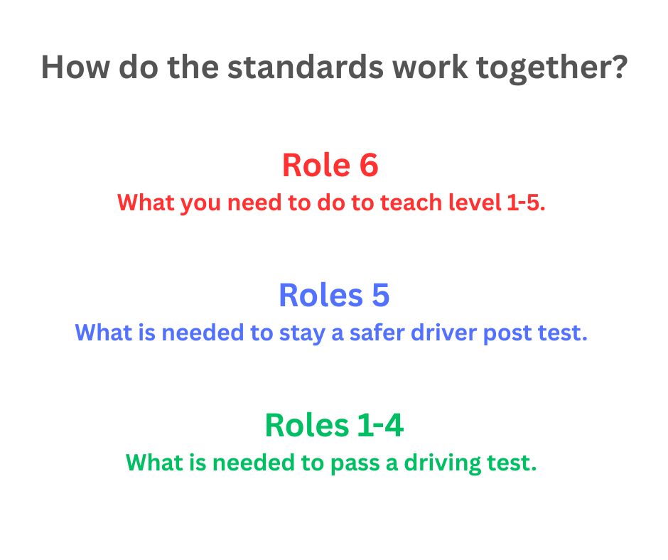

Slide 13
National standard for driving cars and light vans
Role 1: Prepare yourself, the vehicle, and its passengers for a journey
Role 1
What you must be able to do and understand when to prepare yourself, the vehicle and its passengers for a journey.
Unit 1.1: Prepare yourself and passengers for a journey
Unit 1.2: Make sure the vehicle is safe to drive
Unit 1.3: Plan a journey

Slide 14
National standard for driving cars and light vans
Role 2: Guide and control the vehicle
Unit 2.1: Start, move off, stop and leave the vehicle safely and responsibly
Unit 2.2: Drive the vehicle safely and responsibly
Unit 2.3: Drive the vehicle while towing a trailer or caravan

Slide 15
National standard for driving cars and light vans
Role 3: Use the road in accordance with The Highway Code
Unit 3.1: Negotiate the road correctly
Unit 3.2: Comply with signals, signs and road markings

Slide 17
Ian Lavell
Introduce yourself to the group.
What do you do?
Where are you based?

Slide 18
National standard for driving cars and light vans
Role 4: Drive safely and responsibly in the traffic system
Unit 4.1: Interact correctly with other road users
Unit 4.2 : Minimise risk when driving
Unit 4.3: Manage incidents effectively

Slide 19
National standard for driving cars and light vans
Role 5: Review and adjust driving behaviour over lifetime
Unit 5.1: Learn from experience
Unit 5.2: Keep up to date with changes

Slide 20
National Standard for Driver and Rider Training
Role 6 – Deliver driver/rider training programmes
Unit 1 – Prepare to train learner driver/riders – meet all legal requirements
Unit 2 – Design learning programmes
Unit 3 – Enable safe and responsible driving/riding
Unit 4 – Manage risk to instructor, learner and third parties
Unit 5 - Evaluate and develop your knowledge, understanding and skills in the driver/rider training industry
Unit 6 - Develop and use a programme of role play for trainee instructors

Slide 21

5 Tips for Following the Standards
Plan lessons around the learner
Encourage active learning
Use real scenarios
Constructive feedback
Stay up to date with the standards

Slide 23


