Slide 1

WELCOME
To IDEA
Innovative Driving Education Academy

Slide 2
IDEA Unit 9
Introduction to safeguarding

Slide 3
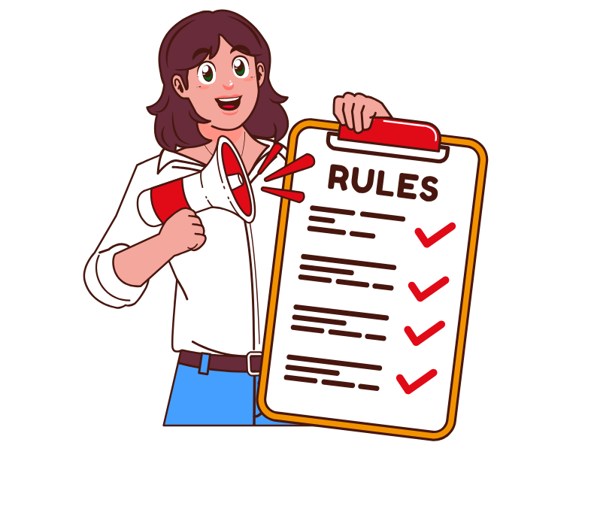
House Rules
Mute Microphones
Take Notes
Interact as much as you need
Use chat
Hand up to speak and unmute
Session is not being recorded

Slide 4
Agenda
What is safeguarding and who is at risk
The acts that make up safeguarding
Types of Abuse
Indicators of types of abuse
Roles and Responsibilities
Sharing Information
Recording Information
First Aid & administration of Medication

Slide 5
Assignments
You must successfully pass the written assessment to achieve the qualification
I will complete a assessment paper from your answers containing 8 open and multiple choice questions needing to achieve a minimum of 15 out of 22 to pass , in a conversation with you all individually.
At end the session i will put people in the waiting room and conduct the assessment
You will not be allowed to have any notes, and for the purpose of the assessment I will need to record the assessment. ( This is the way I'm assessed in the safeguarding process)

Slide 6
What is the Meaning of safeguarding?

Slide 7

Safeguarding means protecting a Person’s health, wellbeing and human rights; enabling them to live free from harm, abuse and neglect. It is an integral part of providing high-quality health care. Safeguarding children, young people and adults is a collective responsibility.

Slide 8
What is the definition of a child?

Slide 9

Anyone who has not reached their 18th birthday.
“Children “ therefore , means Children and young people “

Slide 10
What is the definition of a vulnerable adult?

Slide 11
An adult at risk is any person who is aged 18 years or over that may be at risk of abuse or neglect, because of their needs or support.

Slide 12
Safeguarding Legislation
The avoidable death of Victoria Climbié resulted in the biggest changes for 30 years
in safeguarding and child protection. The government initiated an inquiry into Victoria’s death headed by Lord Laming.
Victoria was abused for months by her Great Aunt and her Great Aunt’s boyfriend
Victoria died on the 25th February 2000 with 128 separate injuries to her body
It was found that there were safeguarding failures at every level, and in every organisation. With repeated failures of basic professional practice
Victoria was known to three housing departments, four social services departments, two GPs, two hospitals, an NSPCC-run family centre and two police child protection
teams, but the abuse and neglect did not come to light until after her death
England , Northern Ireland ,& Wales each have their frameworks setting out duties and responsibilities of organisations to keep children and vulnerable adults safe.
Scotland as its own different legislation, that is different to the parts of the british isles

Slide 13
• Lord Lamming recognised that safeguarding and promoting the welfare of children is everyone’s responsibility. Most importantly, the child should remain at the centre of everyone’s thinking
A green paper outlining a framework of outcomes expected for all children
to attain was launched soon after the inquiry. The green paper is titled:
Every Child Matters and the five key outcomes include:
To be healthy To stay safe To enjoy and achieve
To make a positive contribution To achieve economic wellbeing

Slide 14

The acts that make up the safeguarding legislation
The Care Act 2014
The Care Act 2014 is the most significant reform of the social care in the last 60 years , replacing
previous laws relating to vulnerable adults in care or being cared for. The act aims to clarify the duties of local authorities and other bodies to ensure vulnerable people are aware of what care and support they are entitled to.

Slide 15
The Children Act 1989
The Children act 1989 is seen as the first significant law which put into place most of the child protection
structures and principles we use today.
The act allocates duties to all parties involved , including local authorities ,police ,parents and other agencies
in the united kingdom to ensure children and vulnerable adults are safeguarded and welfare is promoted.

Slide 16
Equality Act 2010
The Equality Act 2010 legally protects people from discrimination in the workplace and in wider society.
It replaced previous anti-discrimination laws with a single Act,
making the law easier to understand and strengthening protection in some situations.
When we're making decisions, the Equality Act 2010 gives us a duty to take into account the need to:
eliminate discrimination, harassment and victimisation.
advance equality of opportunity. foster good relations between different parts of the community.

Slide 17

Safeguarding Vulnerable Groups Act 2006
This act was created to help avoid harm or risk of harm. By preventing people who are unsuitable to work
With children or vulnerable adults from gaining access the them through the work environment.
The Act places a situation duty on all those working with vulnerable groups to register and undergo
an advanced vetting process with criminal sanctions for non-compliance .
DBS -Disclosure and Barring service
An Enhanced DBS Currently held by driving instructors
A DBS check is a record of an individual’s unprotected convictions , cautions , reprimands and warnings
and can also include any intelligence held by the police.
The DBS enables organisations in the public , private and voluntary sectors to make safer recruitment
decisions by identifying candidates who may be unsuitable for work especially if it involves children or
vulnerable adults.

Slide 18
What is the definition of abuse?

Slide 19
Abuse is defined as when someone causes “ physical harm “ to you.
The law defines physical harm as an act that causes you pain or injury or that would cause a reasonable person to suffer pain or injury.
Abuse is an act of or repeated physical, verbal, or psychological acts that violate an individual’s human and civil rights
Types of Abuse

Slide 20
Types Of Abuse
The different types of abuse can fall into any of the following 11 categories of abuse
Physical abuse
Sexual abuse
Domestic abuse
Emotional abuse
Physiological abuse
Neglect or self-neglect
Discriminatory abuse
Modern slavery
Financial or material abuse
Organisational abuse
Radicalisation or cyberbullying

Slide 21
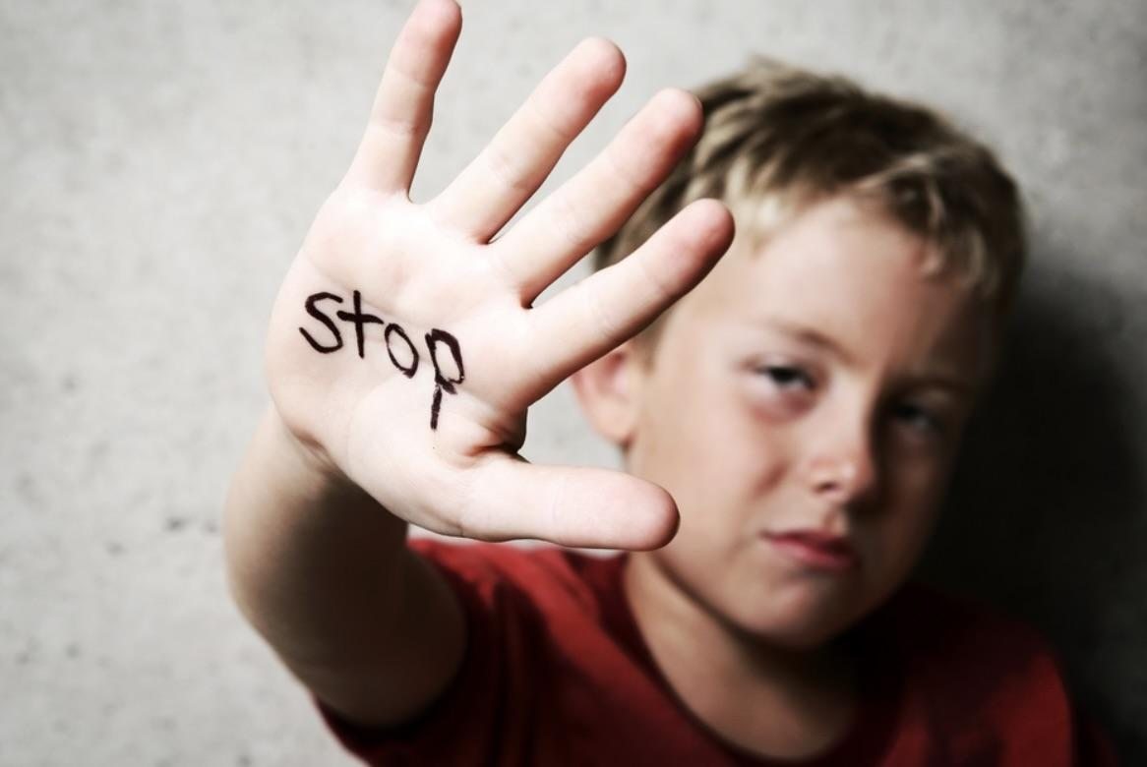
Indicators of types of abuse
Possibly more common to be noticed by driving instructors
Physical Abuse
Injuries in unusual places – back, chest , torso , buttocks , neck , behind the ears , inside thighs , face , back of the hand, or genitals.
Injuries in consistent with age or lifestyle
Apparent fingers marks , slap marks , bites , fractures , burns or scalds
Damage to mouth such as bruised or cut lips
Cluster of injuries forming regular patterns
Injuries at different stages of healing
Object marks or clear outlines of objects
Explanation of injuries is avoided
Delay in seeking treatment for the injuries or behaving aggressively when asked to talk about it

Slide 22
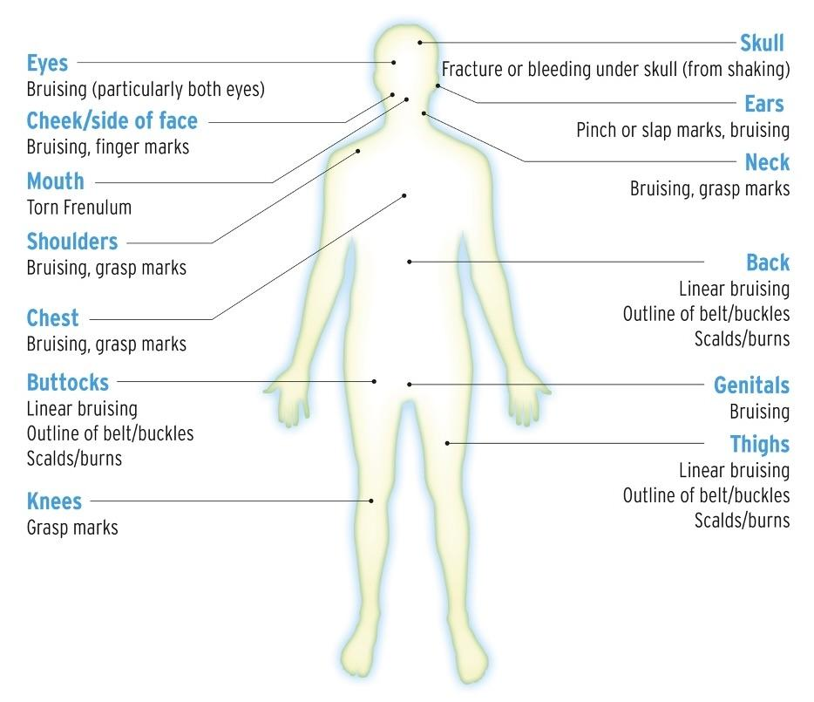

Slide 23
Indicators of types of abuse
Sexual Abuse
A detailed knowledge or language inappropriate to age
Sexually explicit language and Behaviour
Increased frequency of visits to the toilet
Behaviour that is excessively affectionate
Sudden loss of appetite or compulsive eating
Excessive masturbation
Concerning behaviors or unusual interests in specific children – for example grooming
Children who go missing from home or education
Changes in mood or sudden withdrawal from activities
Unexplained gifts or new possessions
A fear of being alone
A fear of medical examinations

Slide 24
What is the difference between sexual assault and sexual abuse?
The primary legal distinction between sexual assault and sexual abuse is the age and capacity of the victim. Sexual assault invloves non- consensual acts with an adult, while Sexual abuse invloves acts with a minor or someone who cannot legally consent.

Slide 25
Indicators of types of abuse
Emotional abuse
Physical , mental and emotional development delays, poor concentration
Difficulty in genuine trust , intimacy and affection, emotional withdrawal
Negative , hopeless and negative view of self , family or society
Lack of empathy , compassion and remorse , Change in appetite
Difficulty in making friends, Sudden speech disorders
Unexplained fear and or defensiveness
Extremes of passivity and aggression
Carer shows little warmth and affection towards a child
Low self –esteem or resignation

Slide 26
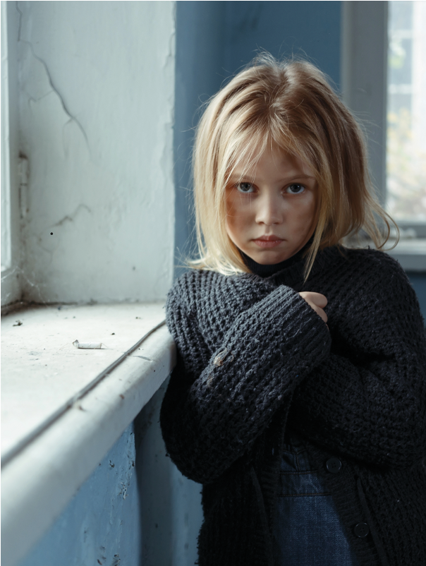
self -neglect
Self-neglect covers a wide range of behaviour neglecting to care for one's personal hygiene, health or surroundings. The definition of self-neglect excludes a situation in which a mentally competent older person, who understands the consequences of his/her decisions, makes a conscious and voluntary decision to engage in acts that threaten his/her health or safety as a matter of personal choice.
Possible indicators: Very poor personal hygiene; lack of essential
food, clothing or shelter; malnutrition and/or dehydration; neglecting
household maintenance; collecting a large number of animals in
inappropriate conditions; non-compliance with health or care services;
inability or unwillingness to take medication or treat illness or injury.

Slide 27

TERRORISM, EXTREMISM AND RADICALISATION
ISM, EXTREMISM AND RADICALISATION
People may become involved in terrorism or violent extremism for many reasons, including:
Terrorism in the UK can involve the exploitation of adults at risk and children. Individuals involved in extremist activity come from a range of backgrounds and experiences – there is no such thing as a “typical extremist”.
To defend their culture and beliefs
Peer pressure by friends and family
A lack of identity in society
Radicalisation is the word commonly used to describe the mental process the person is going through as they get drawn down a dangerous path. If someone is becoming radicalised it means they are displaying extreme views in support of extreme ideologies or beliefs, terrorist groups and activities
Radicalised by extremist groups
Seeking vengeance or retaliation

Slide 28
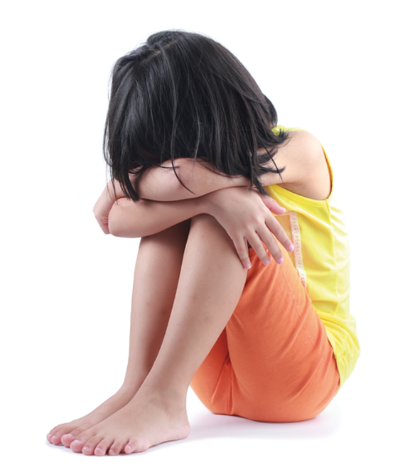
DISCRIMINATORY ABUSE
May involve: Types of harassment or insults because of someone’s race, gender, gender identity, age, disability, sexual orientation or religion.
Possible indicators: Lack of respect shown to an individual; signs of a sub-standard service offered to an individual; repeated exclusion from rights afforded to citizens such as health, education, employment, criminal justice and civic status.

Slide 29
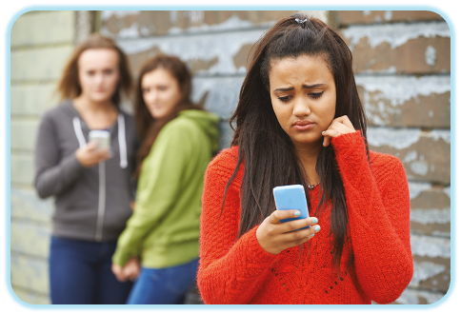
Bullying or Cyberbulling
Bullying is also recognised as a type of abuse. It is always distressing for the victim and can have serious consequences and therefore should always be taken seriously. Bullying happens when an individual or group of individuals show hostility towards another individual and this can be emotional, physical, sexual or racist.
Cyber-bullying: Occurs through emails, text messages, telephone calls or sharing information about an individual on social networking sites. Children who use this method of bullying often feel disassociated from their actions, but the consequences can be just as serious for the child. It can be particularly distressing or the victim.

Slide 30
Roles And Responsibilities
Safeguarding is Everyone’s Business
Everyone who works with or comes into contact with children or vulnerable adults
have a part to play in safeguarding and promoting the individual’s welfare
SAFEGUARDING PARTNERS
Government agencies have significant involvement in safeguarding and promoting
the welfare of individuals.
This is led by three KEY BODIES who make up the local safeguarding partnership

Slide 31

These are the three KEY BODIES who make up the local safeguarding partnership
•Local Authorities
•Police
•NHS clinical care commission group

Slide 32
SAFEGUARDING PARTNERSHIP
The key responsibilities of the safeguarding partnership are to:
• Involve relevant agencies in the area
Identify and supervise the review of serious safeguarding cases
Publish local safeguarding arrangements
Arrange for independent scrutiny of their arrangements
Publish annual review reports on their safeguarding activities

Slide 33
Roles And Responsibilities
The safeguarding lead is often referred as within a business
The safeguarding lead would ideally be a person who is :
Being the central point of contact within the business
Responding to any safeguarding concerns
Keeping records safe in Data Protection Act
It is not the safeguarding lead’s responsibility to investigate or assess whether child or vulnerable adult is
At risk of abuse or harm or likely to suffer significant harm

Slide 34

Roles And Responsibilities
Several high- profile safeguarding cases have been highlighted with tragic consequences
In light of this, many areas have established MULTI- AGENCY SAFEGUARDING HUBS
Benefits of MASH
More accurate assessment of risk and need
More thorough and driven management of cases
Better understanding between professions
Greater efficiencies in processes and resources
Every council in the country should have a Multi-Agency safeguarding Hub
Every local authority has a statutory duty to employ a local authority designated officer
The Local Authority Designated officer is responsible for :
Providing Information , advice , and guidance
Managing and overseeing individual cases
Monitoring Progress of cases to ensure they are managed efficiently
Liaising with the police and other key agencies

Slide 35
Statement cases
Let’s discuss these case studies. With these case studies are you
Not Concerned, concerned but not my problem , extremely concerned
Statement 1
A 17, year old boy turns up to your driving lesson and has a mark on his face. He tells you that he has been slapped by a religious leader. His father has told him that he must always respect his elders

Slide 36
Statement 2
A 17, year old girl as started to attend lessons late and never seems to be correctly dressed , just lately she seems to be scruffy, and her hair is general greasy and unwashed.when you have dropped her off at college you have noticed that other girls make fun of her.

Slide 37
Statement 3
You drop your student of at their house every week at the same time and notice the neighbour’s 11 year-old child regularly returns home from school with her 8 year-old brother to an empty house. When you ask your student about them, you're pupil says their dad is a single parent does not get back from work until 6.30pm.

Slide 38
Sharing Information
Golden Rules
The seven Golden rules to sharing Information.
1.Remember the Data protection act 2018 is not a barrier to sharing information
2.Be open and honest
3.Seek advice
4.Share with the consent where appropriate
5.Consider safety and well being
6.Necessary , proportionate , relevant , accurate , timely and secure
7 Keep a record

Slide 39
Golden Rules
A child or young person , vulnerable adult may have talked to several people about an issue of abuse before they’ve talked to you, or it may be the first time they have told their story
FACTORS PREVENTING DISCLOSURE
1.Having no one to turn to regarding their concerns
2.Not wanting to burden others
3.Fears and anxieties manipulated by the perpetrator
4.Development delays
5.Emotional barriers
6.Anxiety over confidentially of the information they provide

Slide 40
Sharing Information - What you should DO
Responding to disclosure : if you are approached by a young person, vulnerable adult with a disclosure that they are being or have been abused .
Stay calm , listen very carefully to what is being said to you and do not interrupt.
Always reassure the individual and be sympathetic , do not make jokes or change the subject
Do not make disbelieving comments : such as “He would never do that to you surely “ or
“I'm sure they didn’t mean it “
Tell the individual they have done the right thing in telling you and you are treating the information seriously
Explain to the individual that you will need to communicate their concerns with an appropriate person
such as the safeguarding lead.
Report to the safeguarding lead with the information you have gathered

Slide 41
Sharing Information - What you should NOT DO
Make promises like promise to keep secrets
Be judgmental
Make contact with the alleged abuser
Pass on the information to anyone other than those who are designated to manage disclosures
Pressurise the individual to disclose further information
Stop the individual when they are telling you what as happened to them as they may never tell you again

Slide 42
Recording Information - When recording information is it vital that the information and a detailed report is produced at the time of disclosure
The report needs to include:
Details of the individuals involved including the victim and the alleged perpetrator ( if disclosed)
including names, address details , date of birth , ethnic origin, and any disabilities they may have.
Information regarding the nature of the allegation
A description of any incidents or injury sustained
Time , Date , location and any persons present. A concise account of what is said by the victim , using their own words
Details of the person recording the information (name , role contact details )
Keep a record of any third -party correspondence (e.g. police officer, social care services)

Slide 43
Yourself and safeguarding - Its important to remember that safeguarding is not just about the person who is next to you, it’s a two street ,you and your Pupil and a third way is a third party, what do they see?
Keeping yourself safe :
So, what does not help us do that, here are the DON’T”S
Use oppressive language
Engage in horseplay / Use inappropriate touching
Be alone away from others where applicable
Encourage young people to use inappropriate language
Provide personal care
Engage in sexual activity with under 18’s or be in a relationship with a current pupil
Behave in a manner which would lead any reasonable person to question their suitability to work with young people or vulnerable adults
Store photos on a mobile or share photos on social media unless there is
written agreement with pupil or guardian
To protect yourself :
Adhere to the ADI code of conduct.
Records kept and in line with GDPR
Stay up to date with changes
with safeguarding CPD
Document incidents that
arise in the car
Have a safe and open environment
Maintain professional standards & boundaries

Slide 44
First Aid & administration of Medication
Health and safety legislation places duties on all to ensure appropriate health and safety policies and
equipment are in place and the appropriate person is appointed to take charge of first aid arrangements
Some young people may need medication during some hours or events, in the event of this it would be better
if they could self administer the medication.
Adults or professionals should
Adhere to policies for administering first aid or medication
Have knowledge if the young people or vulnerable adults are on medication,
if required to give information to the emergency services if you are required to contact 999
Comply with the necessary reporting requirements , report and record any
administration of first aid or medication
Always ensure that an appropriate risk assessment is undertaken prior to undertaking certain activities

Slide 45

Emergency contact details card in your car available to report it if you need to – with information on
Like the one below
Emergency & Reporting Contact Information card
•Dial 999 for Immediate Danger
•Use 101 for Non- Emergency Concerns
•MASH- Number for your Area
•LADO- number for your area
•Visit www.gov.uk for detailed information

Slide 46


Slide 47
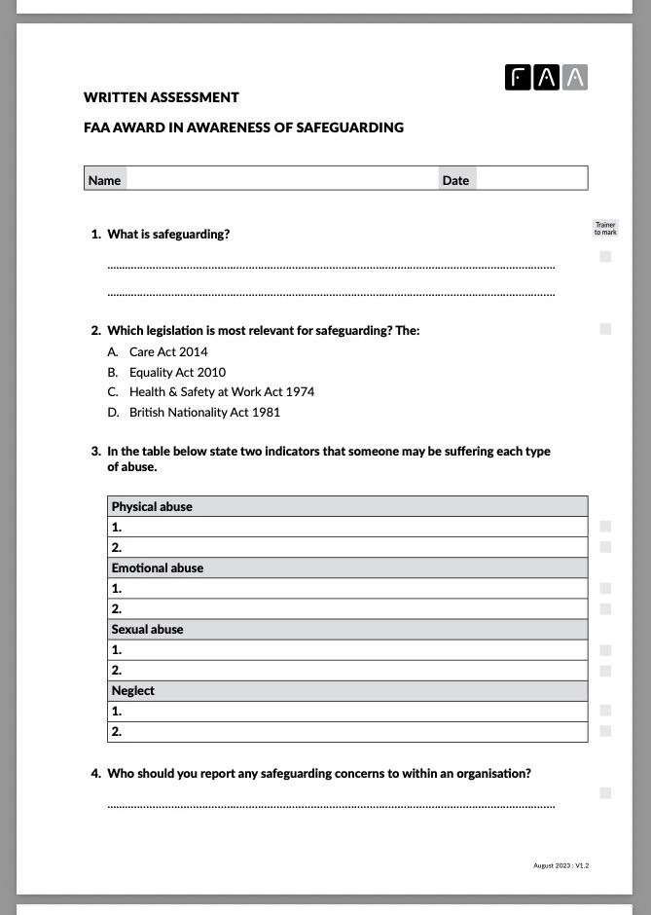
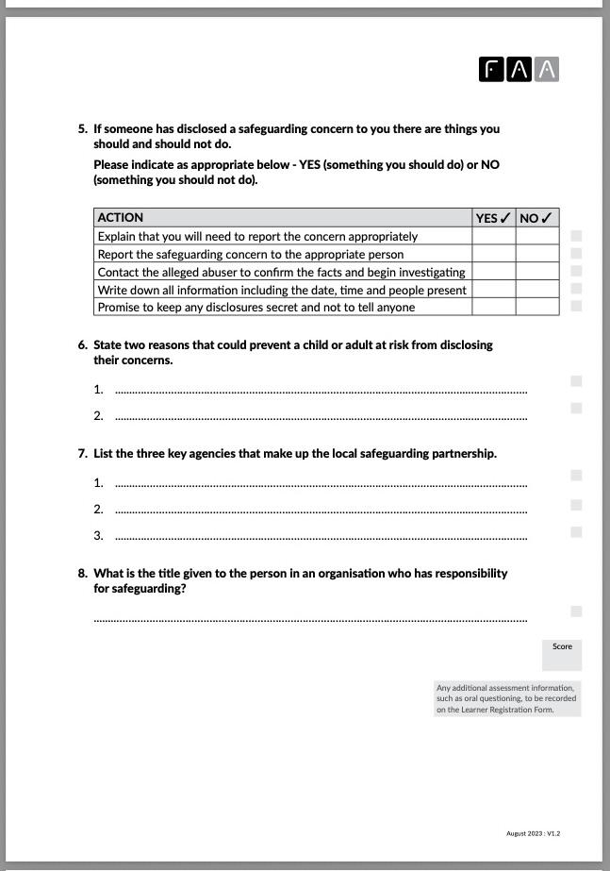
Assignments
You must successfully pass the written assessment to achieve the qualification
I will complete a assessment paper from your answers containing 8 open and multiple choice questions needing to achieve a minimum of 15 out of 22 to pass , in a conversation with you all individually.
At end the session i will put people in the waiting room and conduct the assessment
You will not be allowed to have any notes, and for the purpose of the assessment i will need to record the assessment. ( This is the way I'm assessed in the safeguarding process)

Slide 48
We recommend you read all the blogs, regarding to safeguarding.
Grooming
Stalking & safeguarding
A bystander
Lone Working
Safeguarding concerns 1
Safeguarding concerns 2
The Interconnection between safeguarding, grooming, stalking and lone working.

Slide 49


